Slide 1
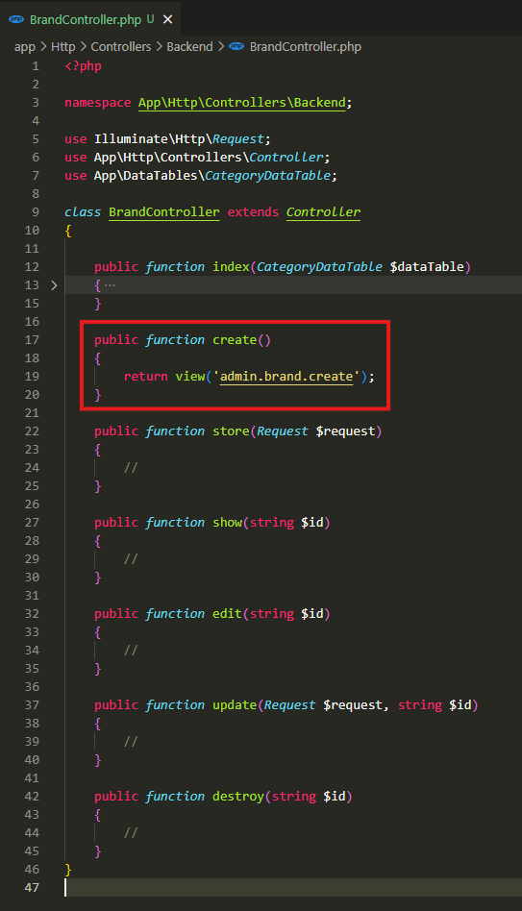
app\Http\Controllers\Backend\BrandController.php

Slide 2
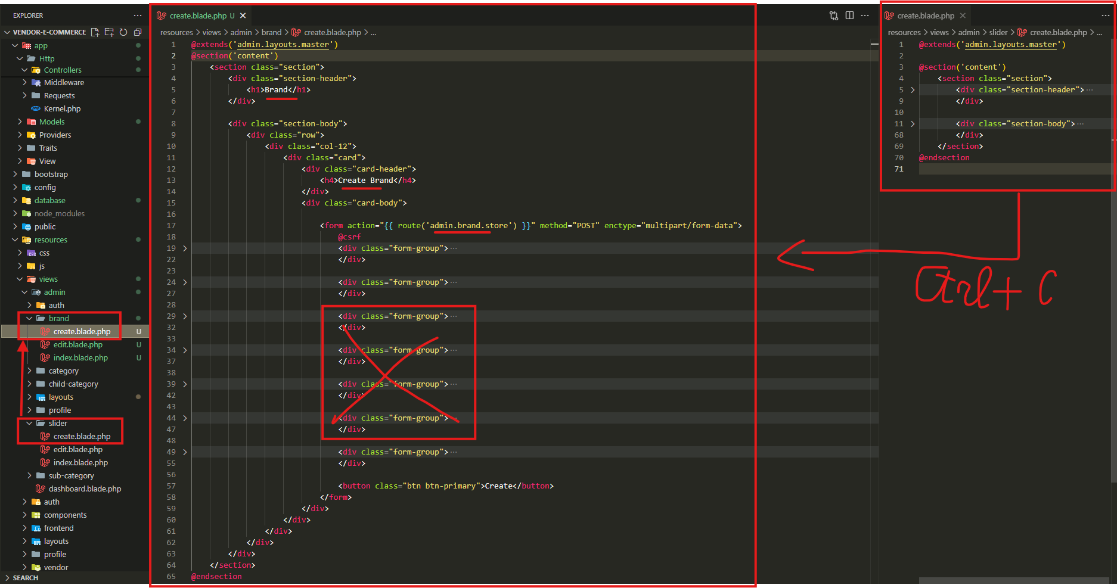
resources\views\admin\brand\create.blade.php

Slide 3
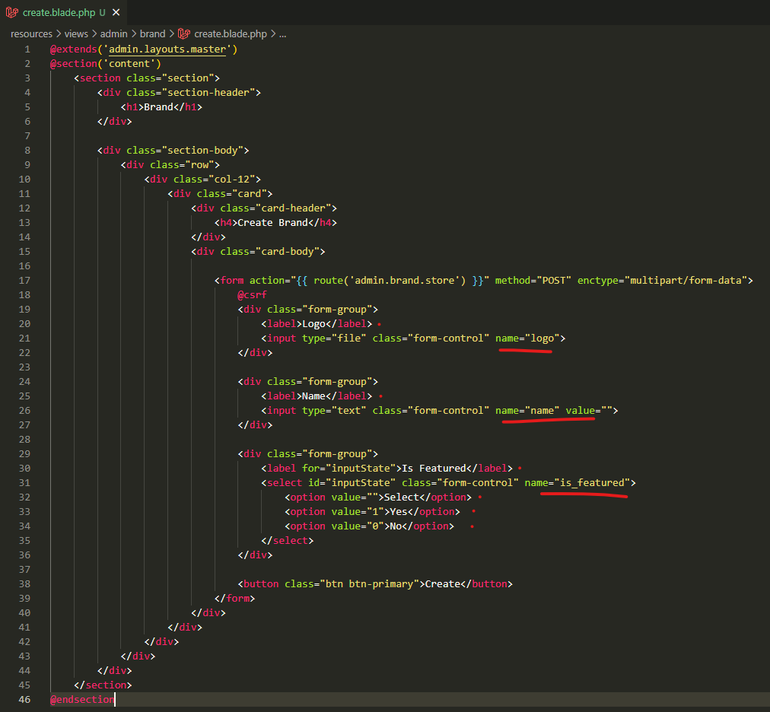
resources\views\admin\brand\create.blade.php

Slide 4
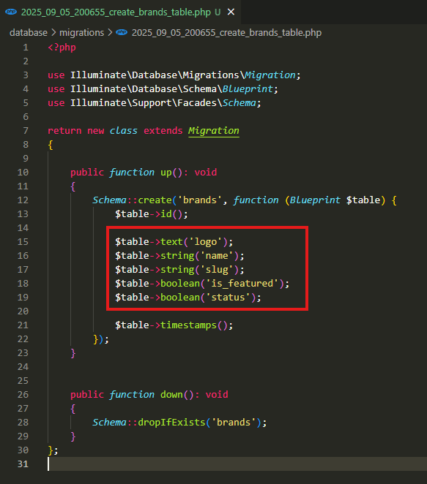
database\migrations\2025_09_05_200655_create_brands_table.php

Slide 5
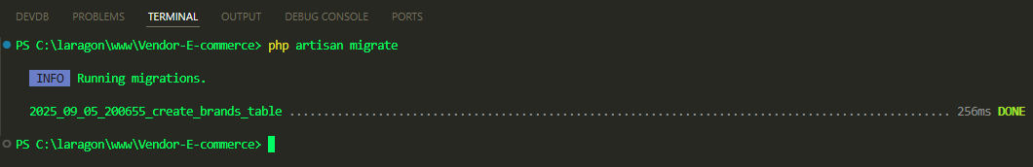
.

Slide 6
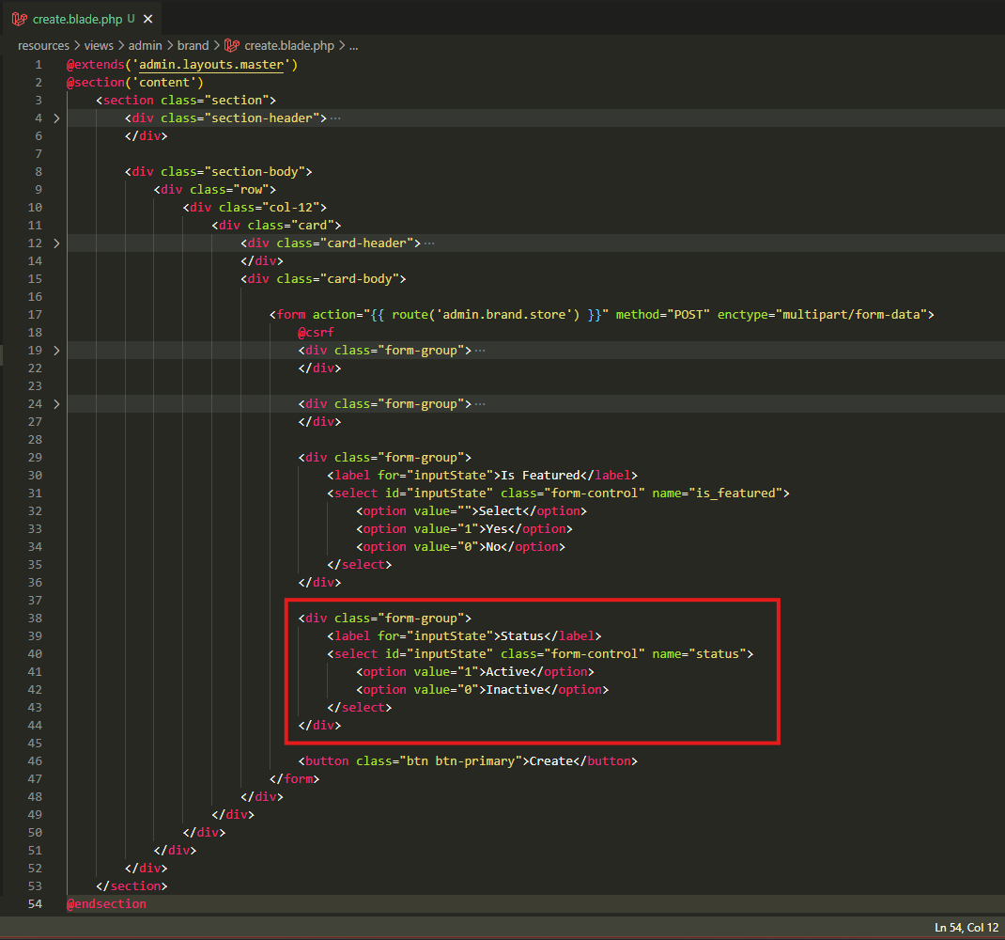
resources\views\admin\brand\create.blade.php

Slide 7
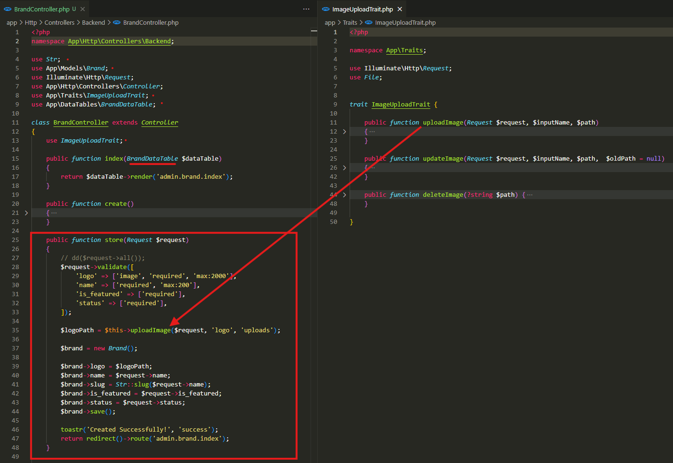
app\Http\Controllers\Backend\BrandController.php

Slide 8
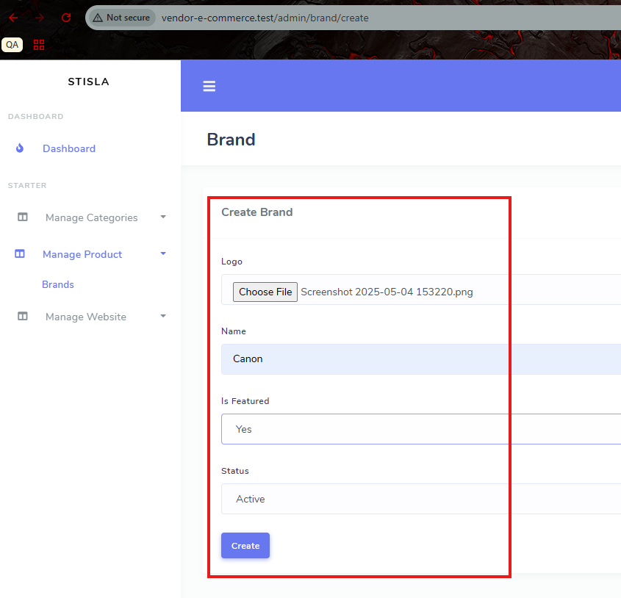
.

Slide 9
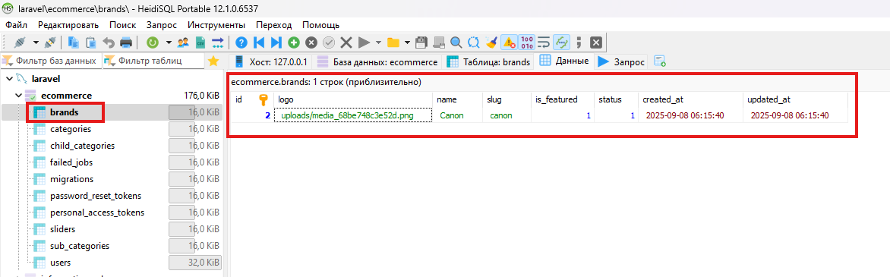
.

Slide 10
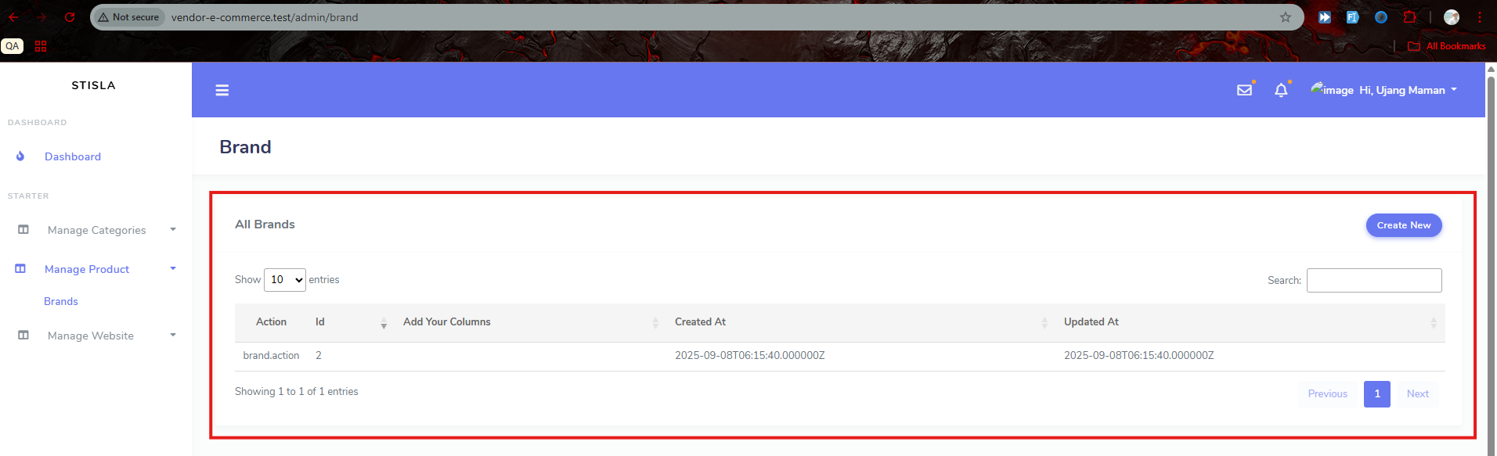
.

Slide 11
.

